Slide 1
Domain mode in two machines

Slide 2
Introduction
If you need to monitor and manage the configuration from one machine and the actual hosts separately, then we can opt for the domain mode on multiple machine.
This can be achieved by keeping the domain controller in a separate machine and the other hosts separately in different machines
In this video, we will see how to create managed domain on two machines,
where one machine is a domain controller (using host-master.xml)
other machine is a host (using host-slave.xml)

Slide 3
Steps involved
Identify the host master (where the domain controller has to run) and the host slave/slaves (where the hosts will remotely connect to the domain controller)
Start domain controller using the host-master.xml
domain.bat --host-config=host-master.xml
Create a management user and copy the secret value
Place the secret value in the host-slave.xml
Add the IP address of the domain controller in the host-slave.xml
Start the JBOSS EAP in the slave machine using host-slave.xml
domain.bat --host-config=host-slave.xml

Slide 4
In this demo:
Host master is running in 192.168.169.137 in the port 9991
Host slave is running in local machine

Slide 5
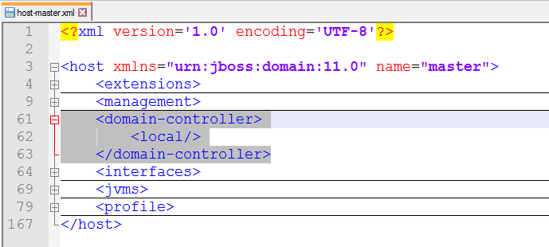
Domain controller section of the host-master denotes whether it is acting as domain controller

Slide 6
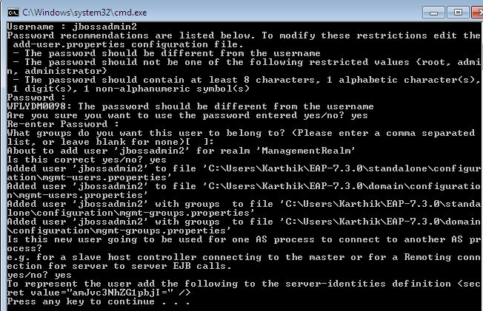
Create a management user

Slide 7
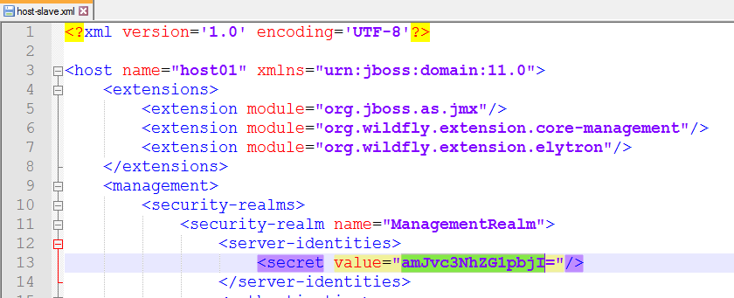
Secret value
amJvc3NhZG1pbjI=
This value needs to be updated in host-slave:

Slide 8
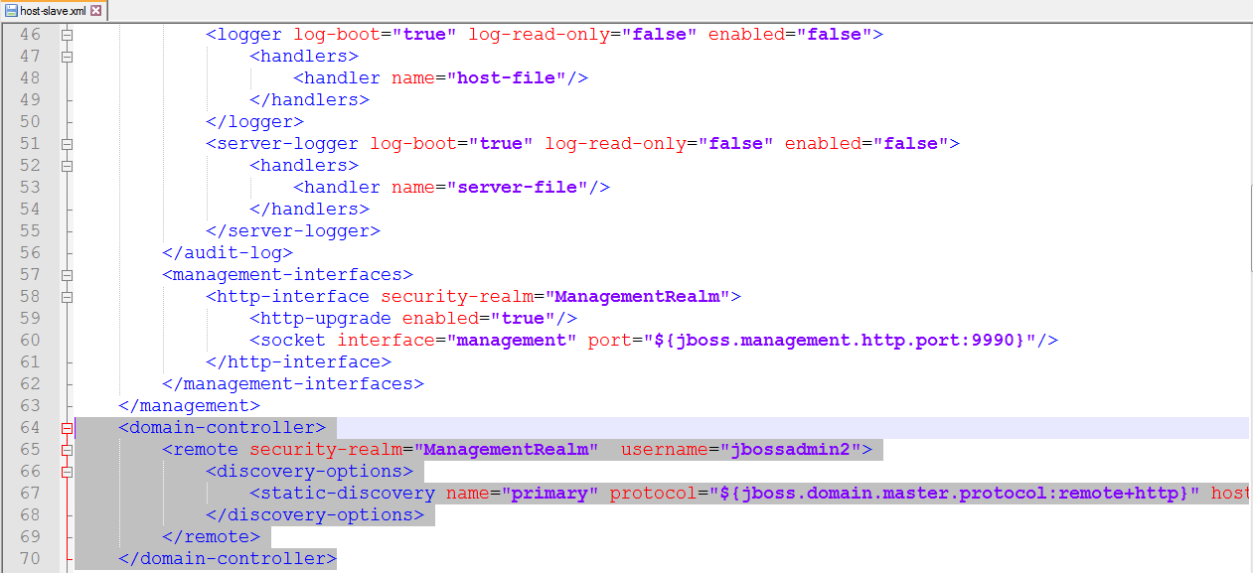
Domain controller section of the host-slave tells which domain controller to connect to

Slide 9
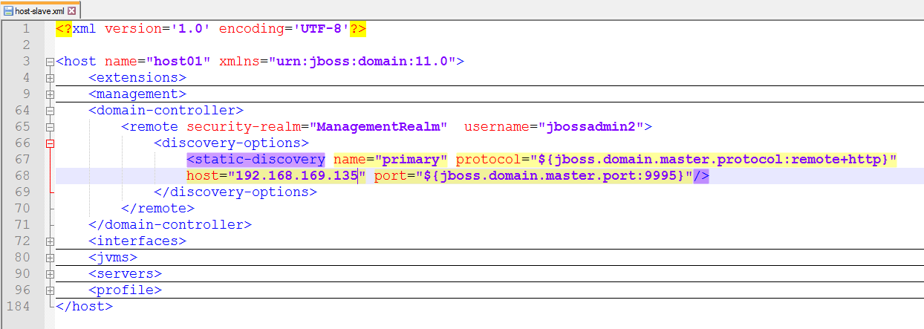
IP address of the domain controller needs to be fed in

Slide 10
How to start the master and slave using IP address in runtime
domain.bat --host-config=host-master.xml -Djboss.bin.address.management=127.0.0.1
domain.bat --host-config=host-slave.xml --master-address=ipaddressofmaster

Slide 11
References
https://access.redhat.com/documentation/en-us/red_hat_jboss_enterprise_application_platform/7.0/html/configuration_guide/domain_management#set_up_domain_two_machines

